Slide 1
Prediction of orders per click and RPC in SEM campaign
Vishal Rishi MK
Mentor – Govind Saria
Manager – Sandip Bhattacharjee
MP Data Science

Slide 2






Problem statement
Understanding the data
Proposed framework
Experiments and results
Next Steps
References

Slide 3
Problem statement

Slide 4
Problem statement
Many of our sellers are trying to market their products using different paid marketing channels. Many a times they spend a good amount of money for marketing the same. But if the return generated (ROAS) is not as they would have expected, they forgo future explorations/investments into paid marketing campaigns like SEM. Some common metrics that quantify the SEM performance are CTR, CVR, RPC, ROAS etc.
If we can predict the performance of an item in an SEM campaign, in terms of metrics like RPC and CVR, the sellers can optimize their spendings in online marketing campaigns.
This motivates us to come up with the problem statement.
Build a machine learning model that can predict Revenue Per Click (RPC) and Conversion Rate (CVR) for an item from a Search Engine Marketing (SEM) Campaign using product information, and other forms of relevant structured data pertaining to GMV, pricing, promotions etc.

Slide 5
Understanding the data

Slide 6
Different types of features
Product description
subcategory, category
Product features
Item price, percent price difference w.r.t amazon
meet-beat flag, two day eligible flag
Performance metrics during SEM campaign
revenue, orders
clicks, RPC
Past transaction data
GMV
number of past transactions
total volume
CVR
quality score, average customer rating
department, super department,
division
catalogue item id, item name

Slide 7
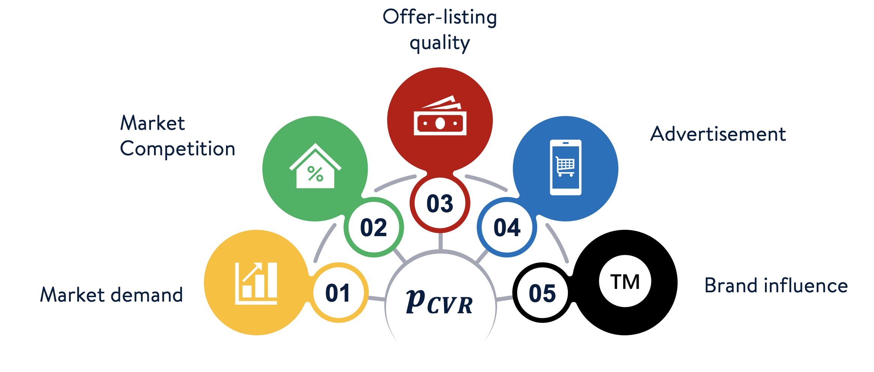
Factors influencing CVR
The target variable CVR, by itself, is an estimate of the true parameter $p_{CVR}$

Slide 8
Key observations
Products that received greater than or equal to 30 clicks (A):
Only 7.8% of the products belong to this group
26.48% of the products in this group have not been converted
Distribution statistics of the feature spend (in USD)
Mean: 98.64
Median: 16.35
Products that received less than 30 clicks (B):
More than 90% of the products belong to this group
91.36% of the products in this group have not been converted
Distribution statistics of the feature spend (in USD)
Mean: 0.59
Median: 0.17

Slide 9
Key Insights
Close to 90% of the data points have their conversion rate and RPC equal to zero (refer appendix)
Less spending on advertisements during SEM campaign led to very few clicks on the impressions
Very few clicks led to poor conversion rates
The estimated CVR would have large variance when the sample size (number of clicks) is less

Slide 10
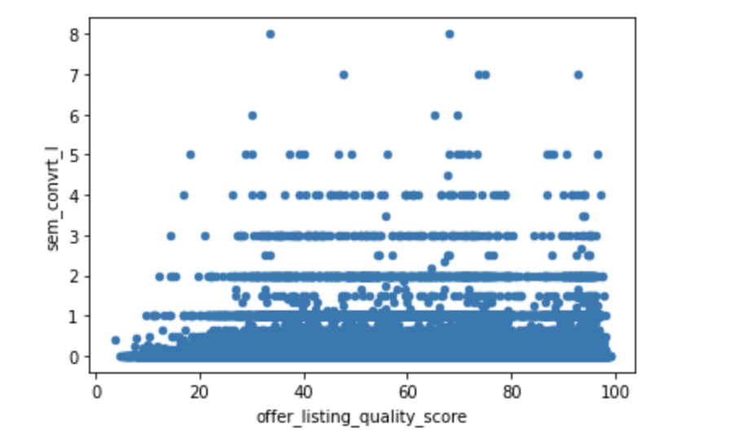
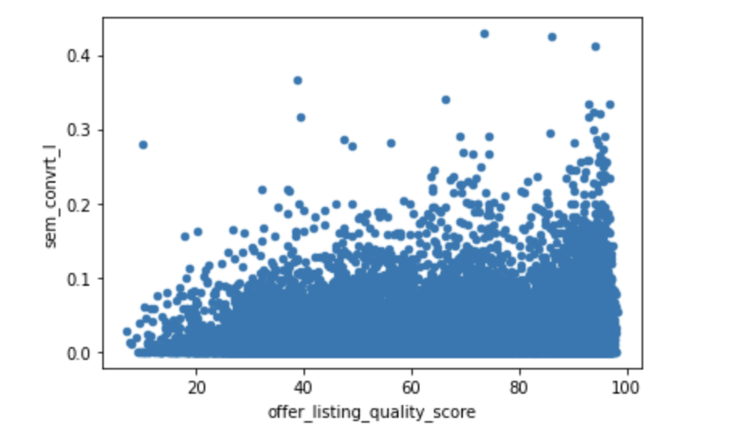
The effect of segmentation
All the datapoints
Products with greater than 30 clicks
Fig: Scatterplot between the quality score and CVR before (left)
and after (right) segmentation

Slide 11
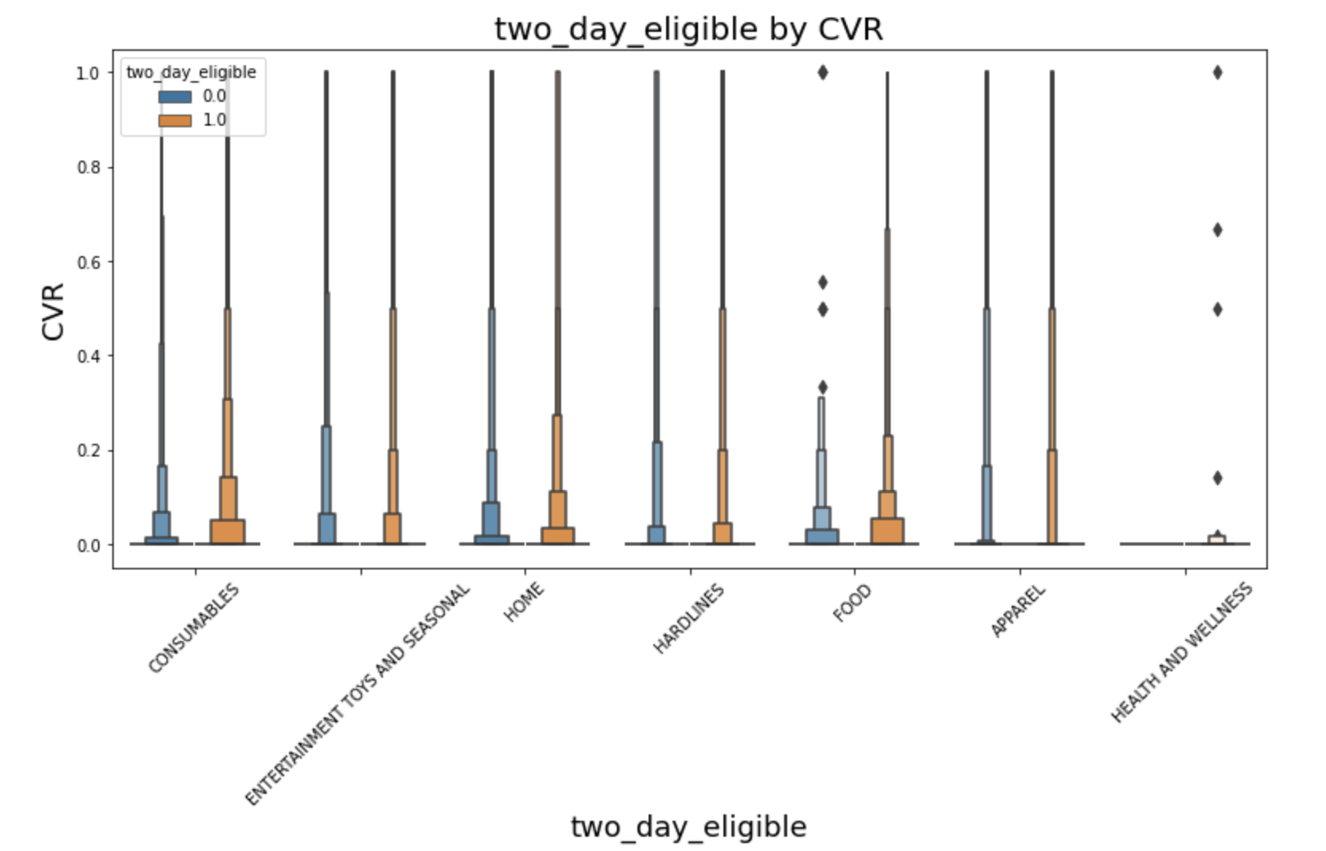
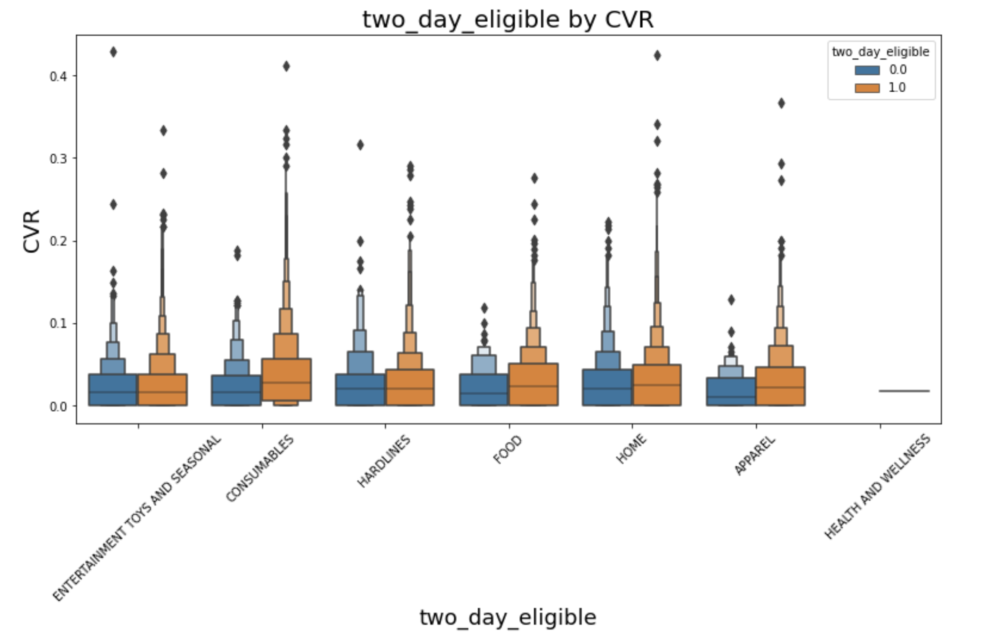
The effect of segmentation
Fig: Before (left) and after (right) segmentation

Slide 12
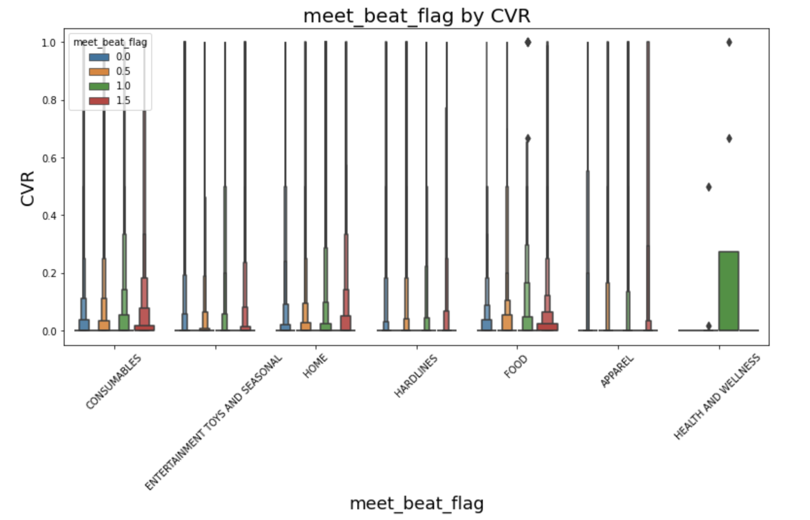
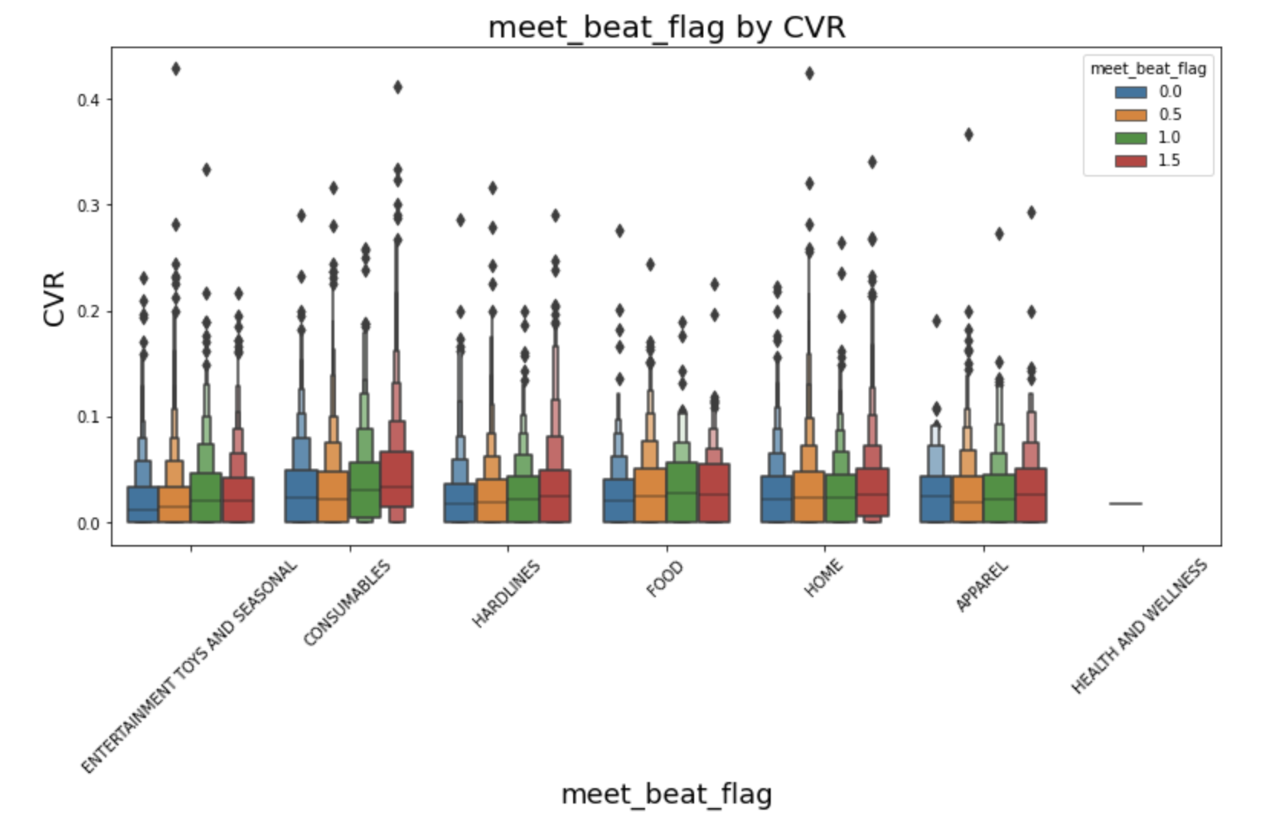
The effect of segmentation
Fig: Before (left) and after (right) segmentation

Slide 13
Proposed framework

Slide 14
Proposed framework - Overview
Products
Segmented products
Modelling CVR
Modelling RPC
Cold-start products
Classification based on clicks

Slide 15
Proposed framework – Modelling CVR
01
02
03
Data preprocessing
Feature selection and engineering
Classification head
Handling missing values
Incorrect data
Eliminating outliers
One-hot encoding
Mathematical transformations like expit, Box-Cox, log etc.
Discretization of numerical features
Hypothesis testing for feature selection
Features from gradient boosted trees
The continuous target CVR is discretized to n bins
A classification head that outputs prior probabilities of an item belonging to a particular CVR bin
06
05
04
Evaluation
Blender
Regression
Mean Cross-entropy
Mean KL-divergence
Mean Absolute Error
Comparison with baseline
Computes the CVR of an item using the prior probabilities and the output from the regression model
A regression model that outputs the exact CVR given that an item belongs to a particular CVR bin

Slide 16
Data preprocessing
Handling missing values for numerical features: the missing values were replaced with their mean (except number of past transactions and total volume. For these variables, a missing value indicates zero past transactions).
Handling missing values for numerical features for categorical variables: the features were one-hot encoded with a separate column for missing values
All the categorical features were one-hot encoded
All the numerical features were standardized
FEATURE LIST:
spend
amt_item_price
num_transaction
total_auth_quantity
offer_listing_quality_score
gmv
meet_beat_flag
two_day_eligible
three_day_flag, and
Features for product hierarchy

Slide 17
Feature selection and engineering
Box-Cox transformations for the numerical features advertisement spending and item price (refer appendix)
After one-hot encoding the categorical features, feature selection is done using the chi-squared statistic (Test of independence)
The chi-squared statistic is computed between all the categorical variables and the discretized target variable CVR
The top-k variables having the highest chi-squared statistic are selected
After all these transformations and feature selection, we are left with 203 features

Slide 18
Experiments and results

Slide 19
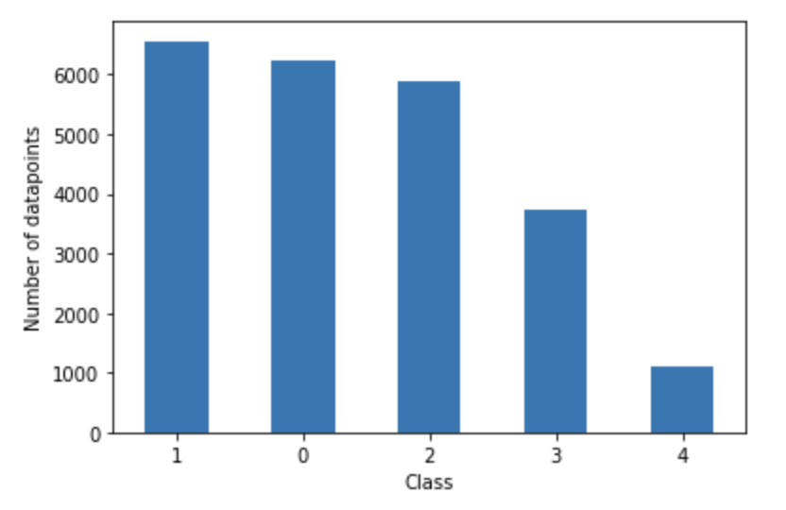
Classification head
We discretize the target variable CVR to n (a hyperparameter) number of classes. We choose n = 5 classes.
The bins are :
Class 0: CVR = 0
Class 1: 0 < CVR <= 0.025
Class 2: 0.025 < CVR <= 0.05
Class 3: 0.05 <= CVR <= 0.1
Class 4: CVR > 0.1
From the figure, we can see that this kind of split does not
produce an imbalanced class distribution
Fig: Class distribution

Slide 20
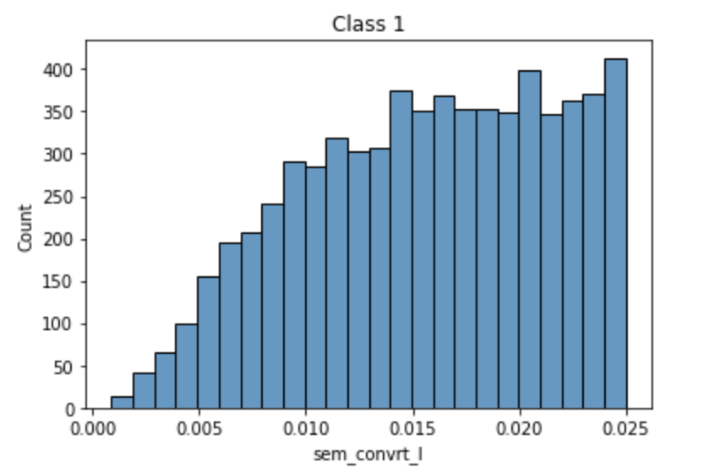
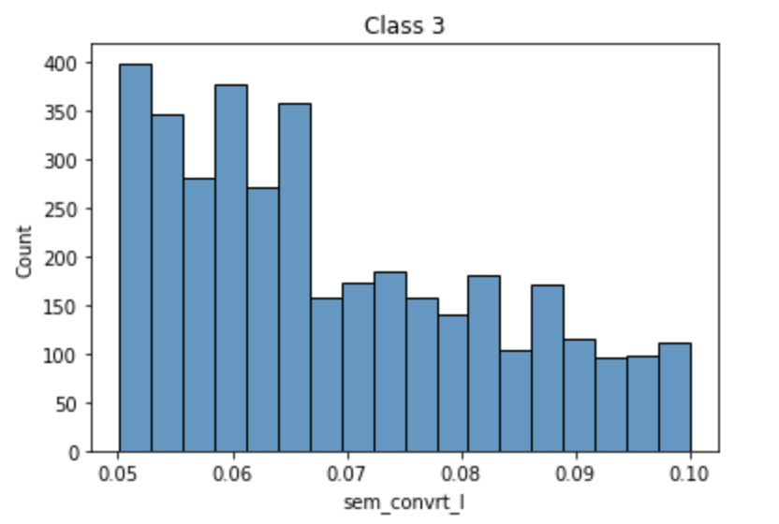
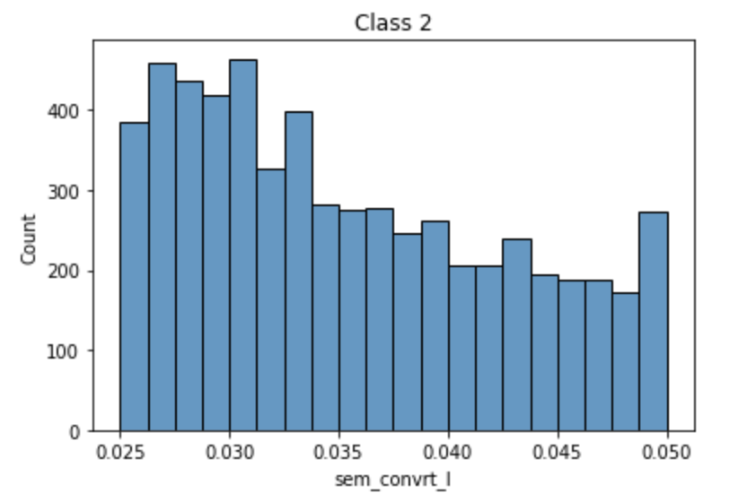
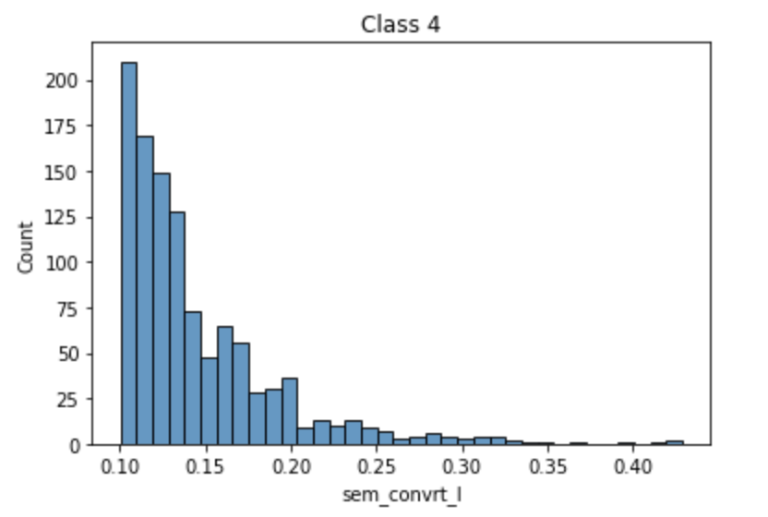
Continued…
Distribution of CVR in each class:
Fig: Distribution of CVR in each class

Slide 21
Classification head
Baseline:
Logistic Regression – One versus Rest approach
Modelling the likelihood – Gaussian mixtures (refer appendix)

Slide 22
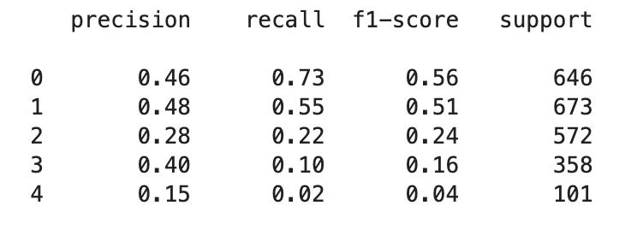
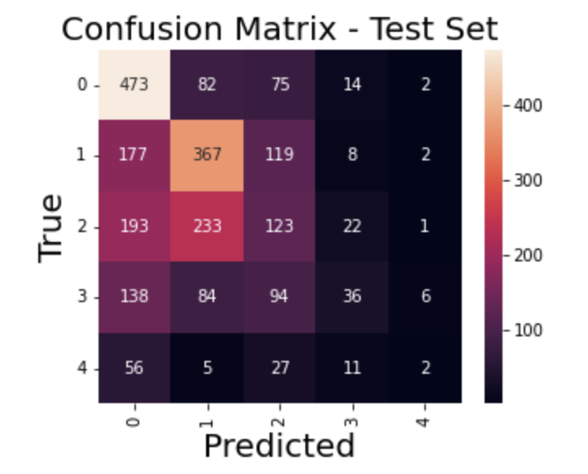
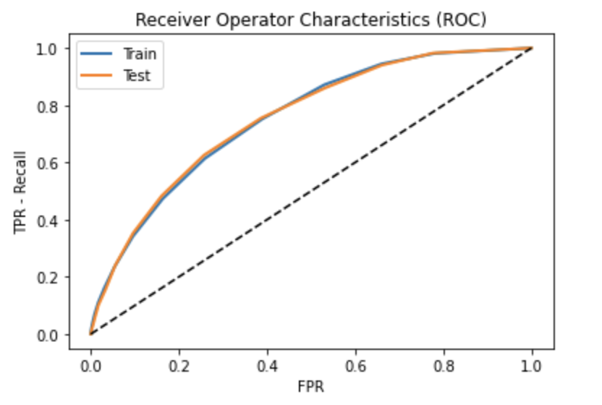
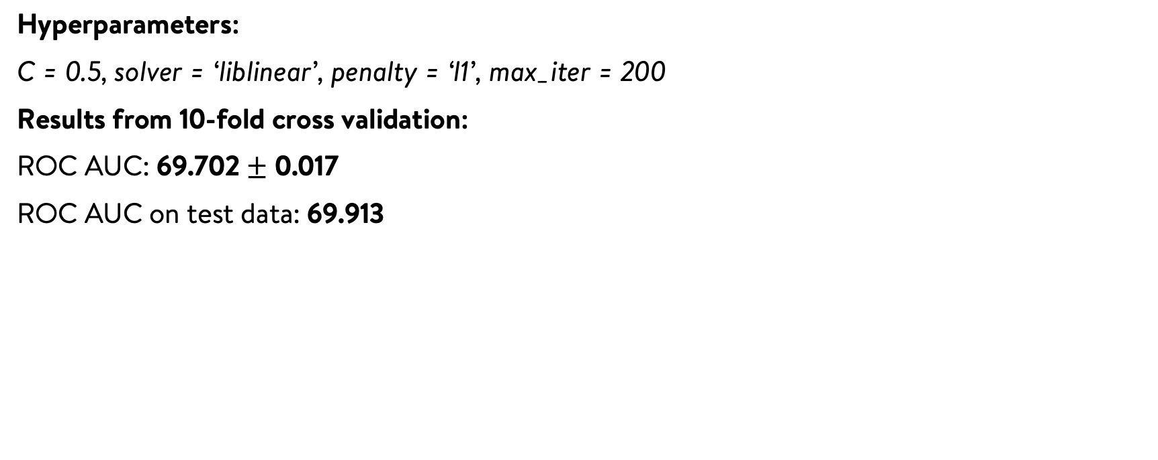
Results – Logistic regression
Hyperparameters:
C = 0.5, solver = ‘liblinear’, penalty = ‘l1’, max_iter = 200
Results from 10-fold cross validation:
ROC AUC: 69.702 $±$ 0.017
ROC AUC on test data: 69.913
Results on test data for each class

Slide 23
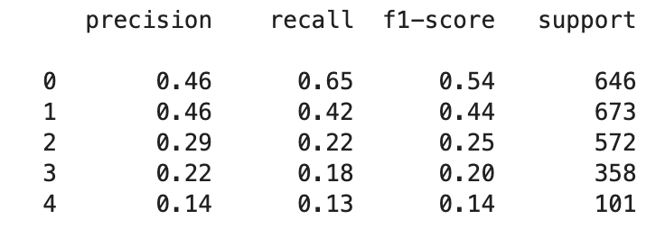
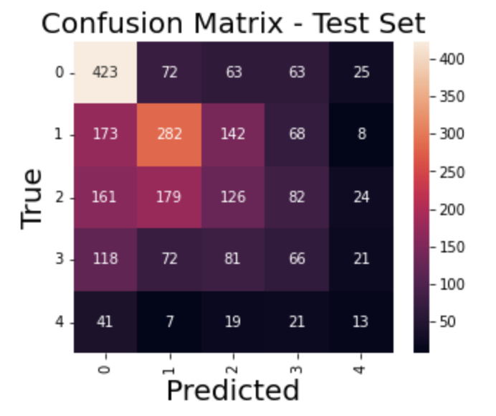
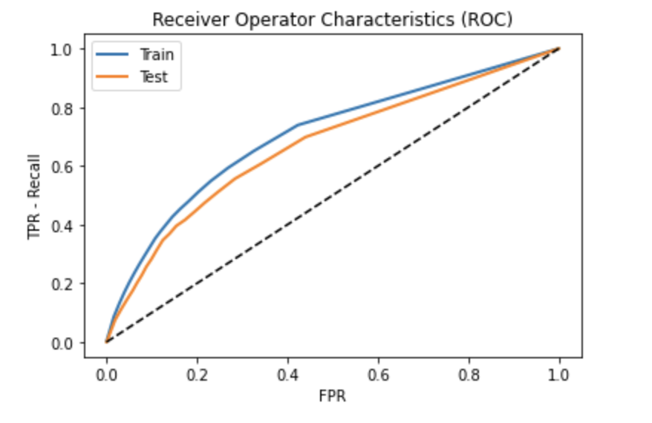
Results – Gaussian mixture modelling
The number of components in each class is chosen
to be the one that minimizes BIC
ROC AUC on test data: 63.891 (worse than baseline)
Results on test data for each class

Slide 24
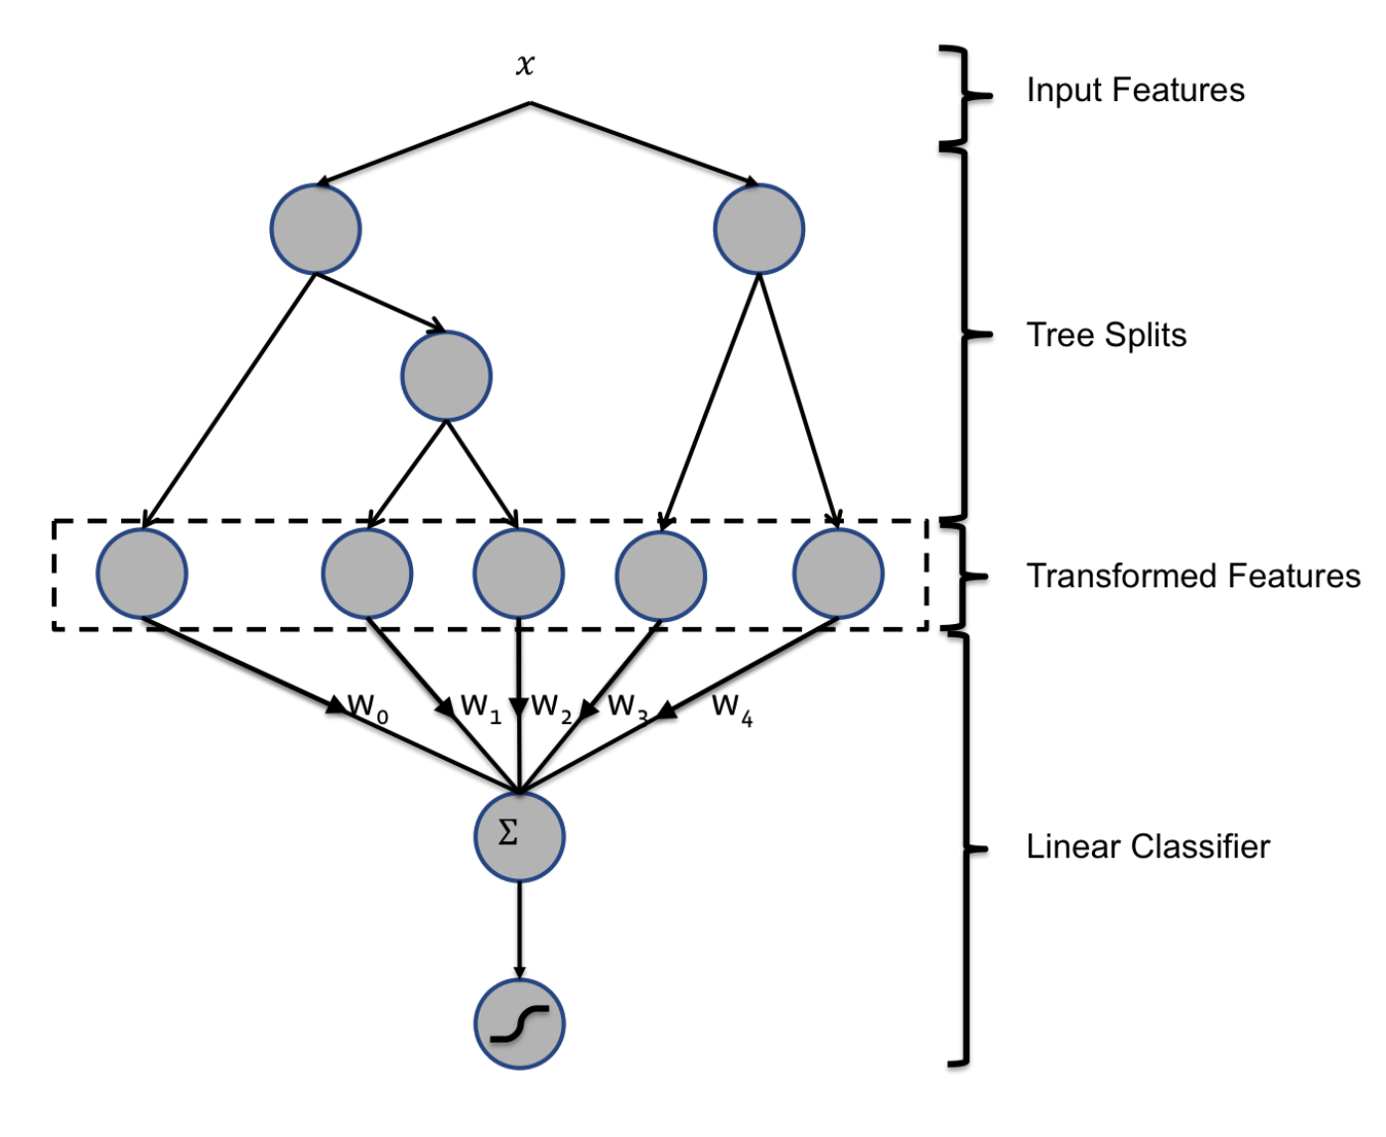
Classification head – Gradient boosting
We train two classifiers:
Gradient boosted decision tree classifier
Logistic regression using (1) as a feature
transformer
Gradient boosted decision trees as a feature
transformer is explained in the figure :

Slide 25
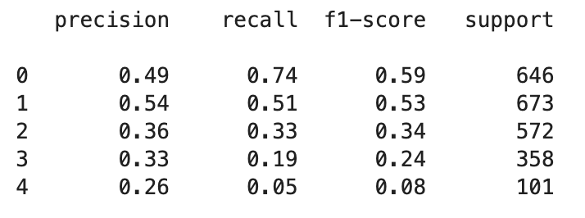
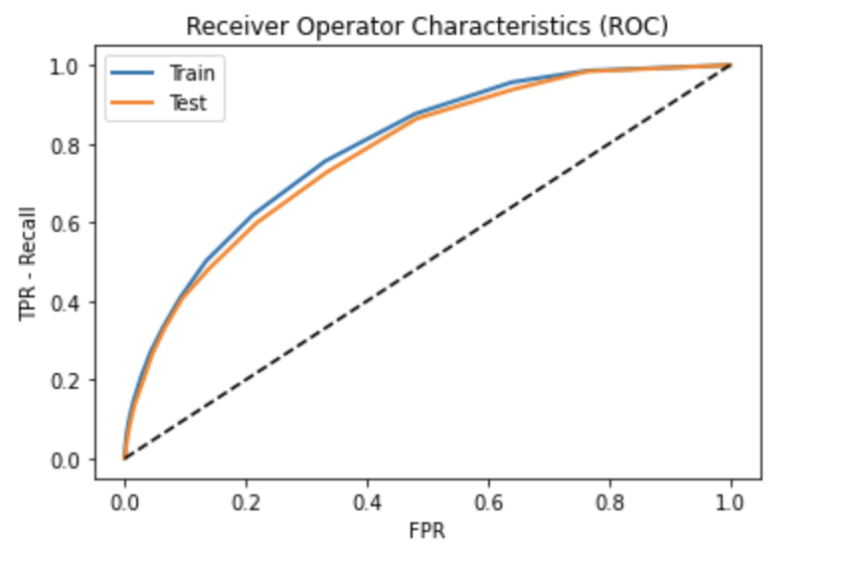
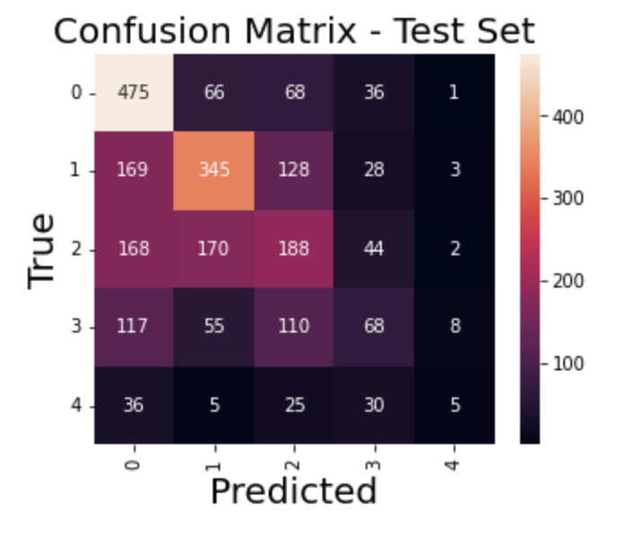
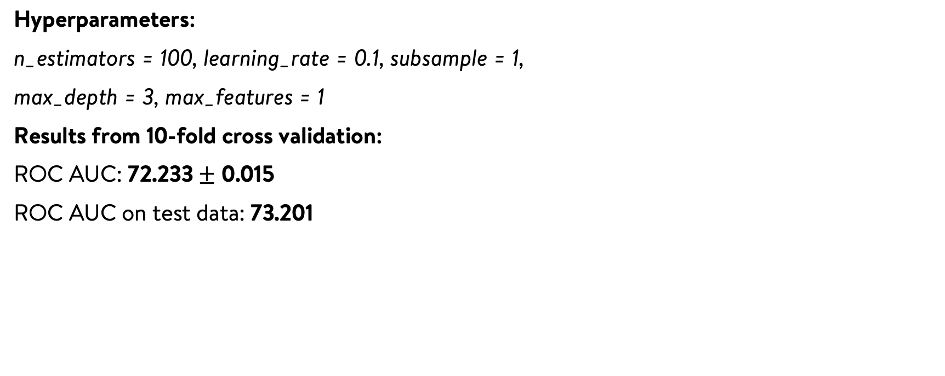
Results – Gradient boosted decision trees
Hyperparameters:
n_estimators = 100, learning_rate = 0.1, subsample = 1,
max_depth = 3, max_features = 1
Results from 10-fold cross validation:
ROC AUC: 72.233 $±$ 0.015
ROC AUC on test data: 73.201
Results on test data for each class

Slide 26
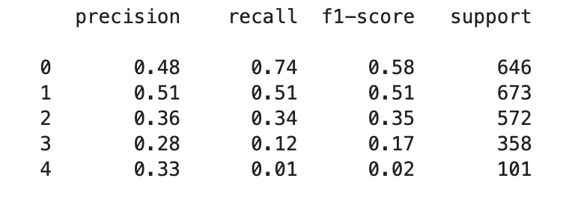
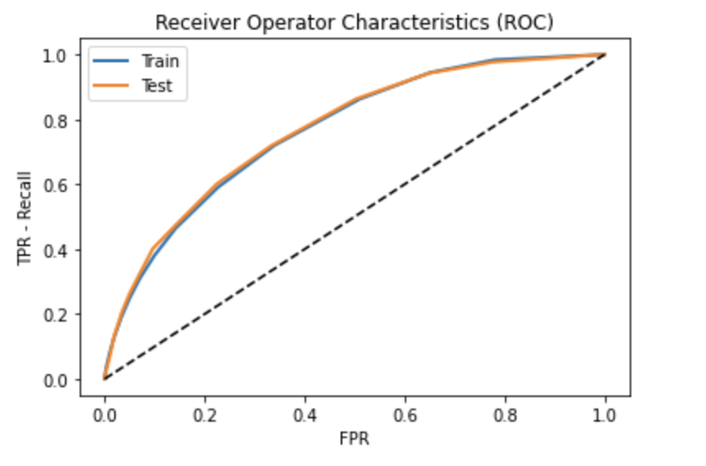
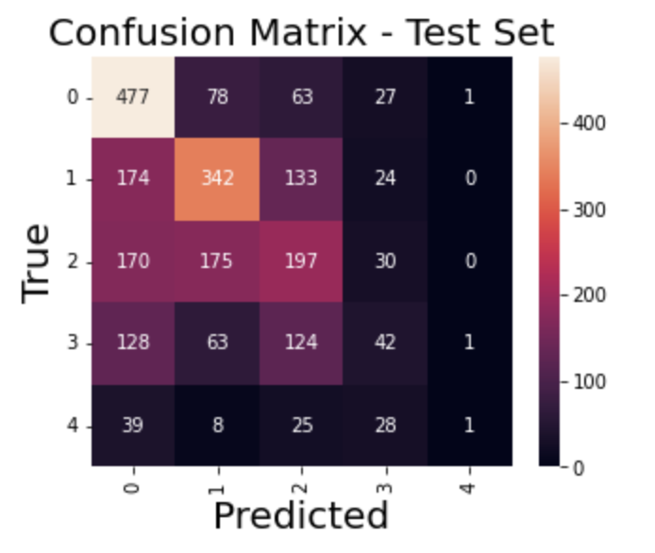
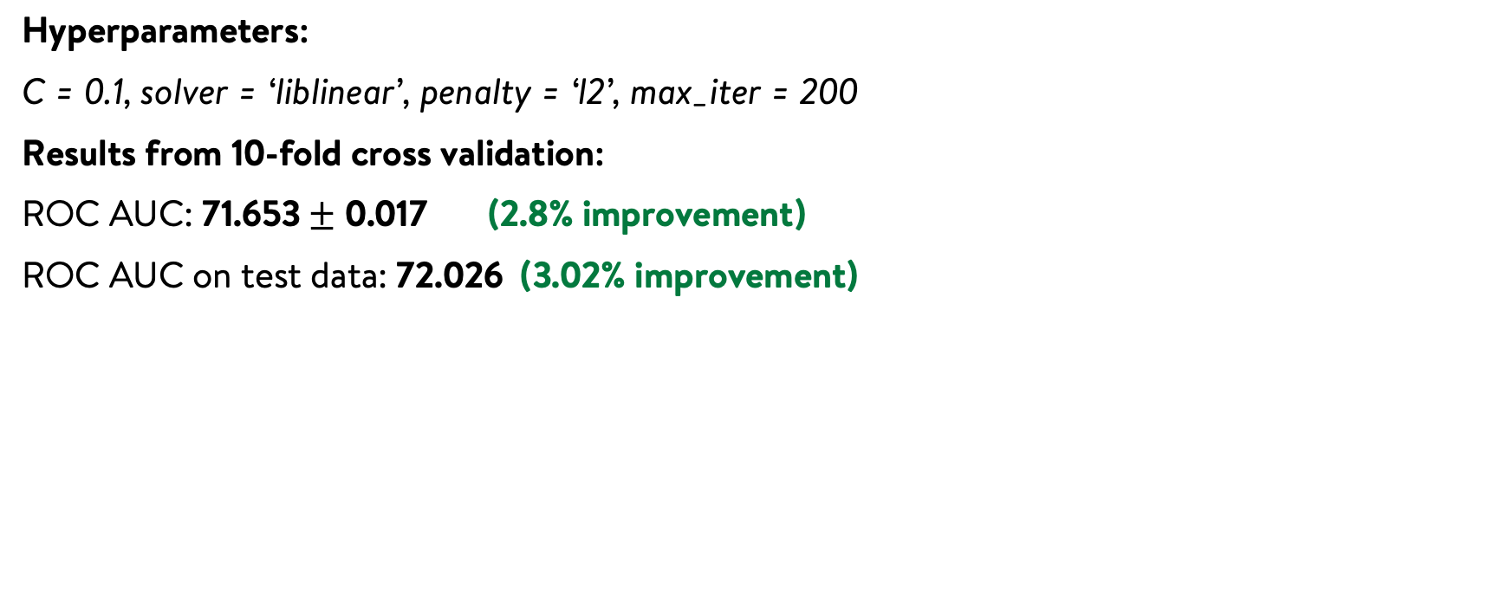
Results – Logistic regression with transformed features
Hyperparameters:
C = 0.1, solver = ‘liblinear’, penalty = ‘l2’, max_iter = 200
Results from 10-fold cross validation:
ROC AUC: 71.653 $±$ 0.017 (2.8% improvement)
ROC AUC on test data: 72.026 (3.02% improvement)
Results on test data for each class

Slide 27
The original features vs the transformed features
We perform K-means clustering using the original and transformed features
Number of clusters is set to 5
We analyze the homogeneity of the clusters

Slide 28
The original features vs the transformed features
Original feature space - silhouette score is found to be 0.2578
Transformed feature space - silhouette score is found to be 0.4004
A higher silhouette score indicates well-formed clusters

Slide 29
Regression

Slide 30
Results – Baseline (Average CVR)
Results on Test data:
Mean cross entropy = 0.1339
Normalized mean cross entropy = 0.8567
Mean KL-divergence = 0.0192
Mean Absolute Error = 0.0253
Class | Mean KL-divergence | Mean Absolute Error (MAE)
Class 0 | 0.0315 | 0.0311
Class 1 | 0.0063 | 0.0157
Class 2 | 0.0010 | 0.0065
Class 3 | 0.0194 | 0.0379
Class 4 | 0.1274 | 0.1150
MAE of all products of a particular class is shown in the table

Slide 31
Beta regression
We train a beta regression model with the transformed features from the gradient boosting classifier
We use the transformed features because it enhanced the classification performance of the classification head
Since the target variable is between 0 and 1 and is interpreted as a probability distribution, using traditional regression loss functions might be inappropriate
The target variable is modelled as beta distribution and the coefficients are estimated using MLE (Maximum Likelihood Estimation)

Slide 32
Results – Beta Regression
Results on Test data
Mean cross entropy = 0.1342
Normalized mean cross entropy = 0.8544
Mean KL-divergence = 0.0195
Mean Absolute Error = 0.0254
The beta regression performs much worse than the baseline, in terms of all the metrics!

Slide 33
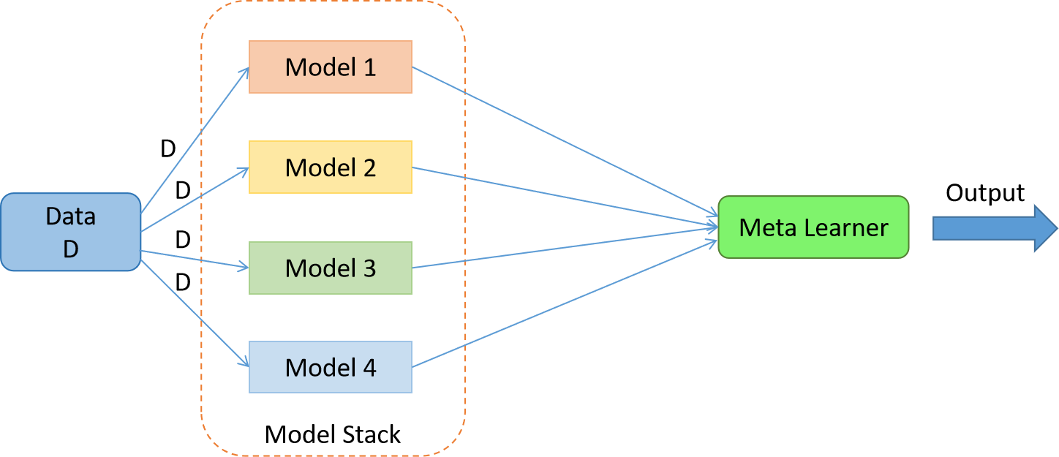

Logistic regression + blender
We train a logistic regression model with the transformed features from the gradient boosting classifier for each class
The blender performs a weighted average of the predictions from all the regression models, with the weights obtained from the classification head (gradient boosted trees)
Data
Blender

Slide 34
Results – Logistic regression + blender
Results on Test data:
Mean cross entropy = 0.1309
Normalized mean cross entropy = 0.8760
Mean KL-divergence = 0.0162
Mean Absolute Error = 0.0228
Class | Mean KL-divergence | Mean Absolute Error (MAE)
Class 0 | 0.0276 | 0.0271
Class 1 | 0.0050 | 0.0125
Class 2 | 0.0026 | 0.0105
Class 3 | 0.0159 | 0.0315
Class 4 | 0.0960 | 0.1021
MAE of all products of a particular class is shown in the table

Slide 35
Key takeaways
The transformed features from the gradient boosted trees improved the performance of the classification head
Though the transformed features were helpful for classification, it was not enough to beat the regression baseline
The logistic regression + blender module reduced the mean KL divergence score by 15% w.r.t the regression baseline

Slide 36
What happens when the number of classes is 2?
We now repeat the same pipeline (classification head + regression) keeping the number of classes equal to two
Class 0: CVR= 0
Class 1: CVR != 0
Classification head – Gradient boosted trees
Regression – Logistic regression + blender

Slide 37
Comparing the results
When the number of classes is reduced, we are decreasing the accuracy of our regression model
This is because the target variable is finely divided when the number of classes is large
This finely divided bins help the blender to make more accurate predictions because it is soft voting
To improve the overall accuracy, the performance of classification head is crucial
Metric | No. of classes = 2 | No. of classes = 5
Mean cross entropy | 0.1315 | 0.1309
Normalized Mean cross entropy | 0.8724 | 0.8760
Mean KL-divergence | 0.0167 | 0.0162
Mean Absolute Error | 0.0234 | 0.0228

Slide 38
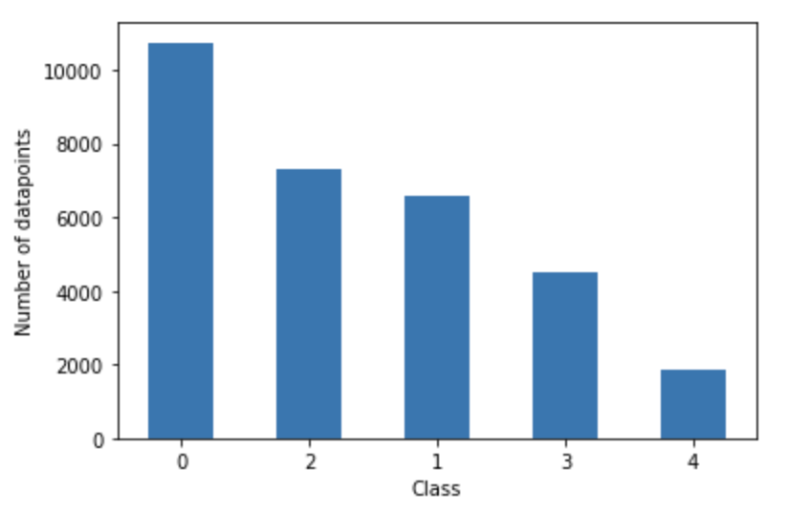
Increasing the coverage
To increase coverage, the threshold for segmentation based on number of clicks is reduced to 20
Fig: Class distribution

Slide 39
Increasing the coverage
No. of products with clicks >= 30 is close to 27k
No. of products with clicks >= 20 is close to 31k
By relaxing the threshold, we are able to increase the coverage by 1.5% and, almost, retaining the accuracy
Going ahead with the cold start problem, we fix the threshold to 20
Metric | Clicks >= 20 | Clicks >= 30
Mean cross entropy | 0.1349 | 0.1309
Normalized Mean cross entropy | 0.8544 | 0.8760
Mean KL-divergence | 0.0207 | 0.0162
Mean Absolute Error | 0.0266 | 0.0228

Slide 40
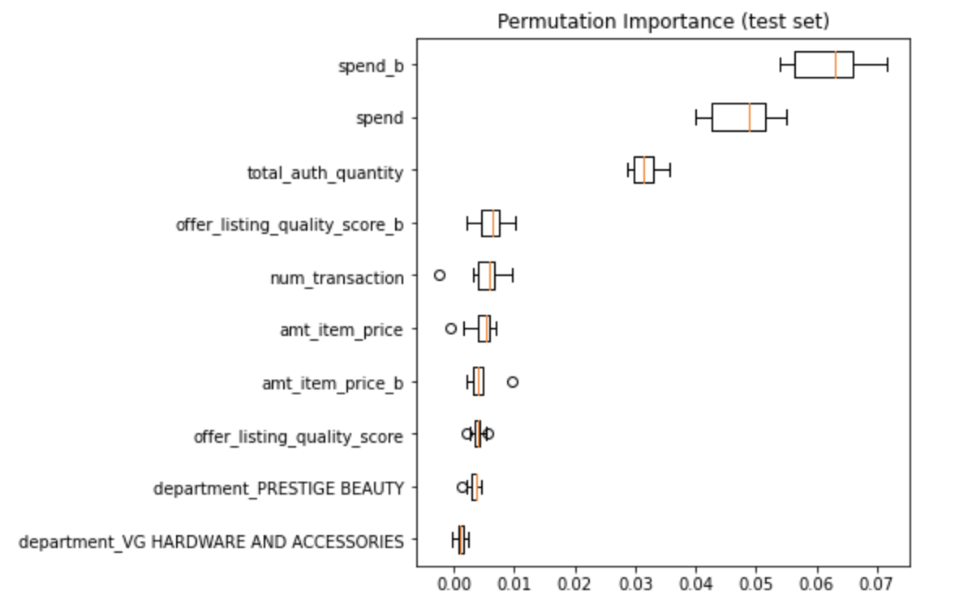
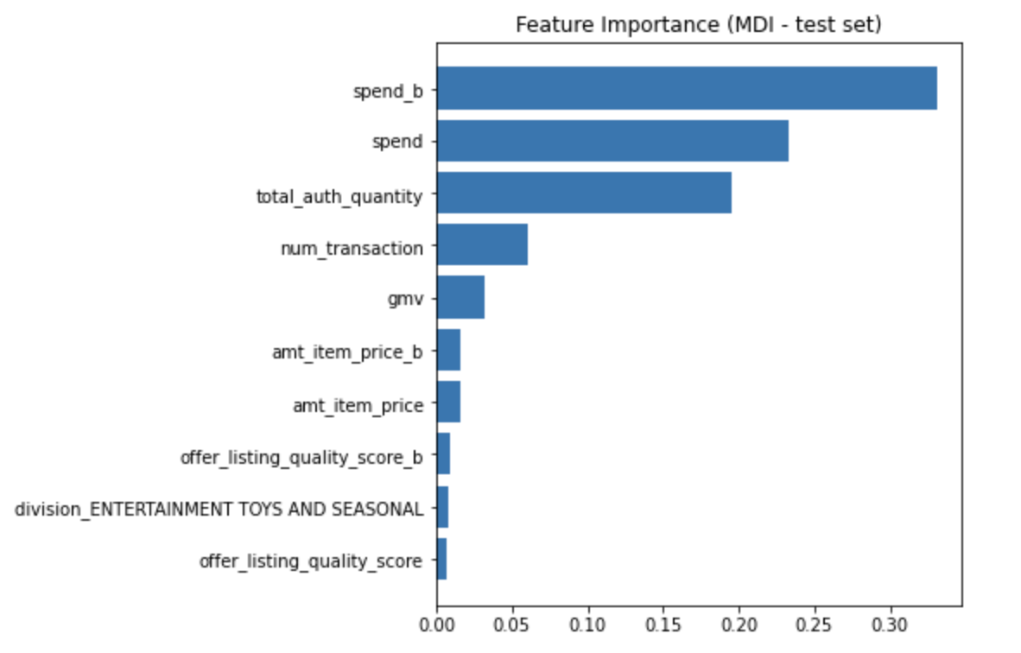
Feature Importance

Slide 41
Cold-start problem

Slide 42
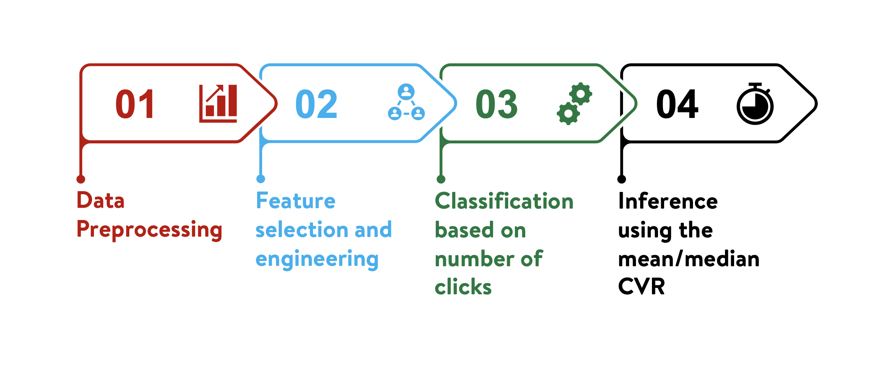
Proposed framework – Cold-start products

Slide 43
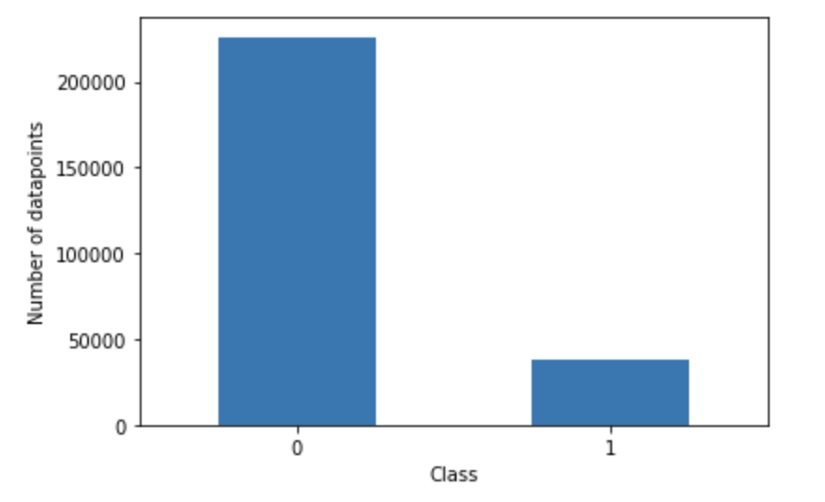
Cold-start problem
We analyze the products that received less than 20 clicks
We discretize the variable clicks to the following classes
The bins are :
Class 0: clicks <= 5
Class 1: 5 < clicks < 20
From the figure, we have an
imbalanced class distribution
Fig: Class distribution

Slide 44
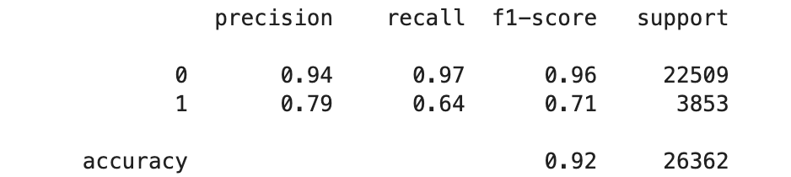
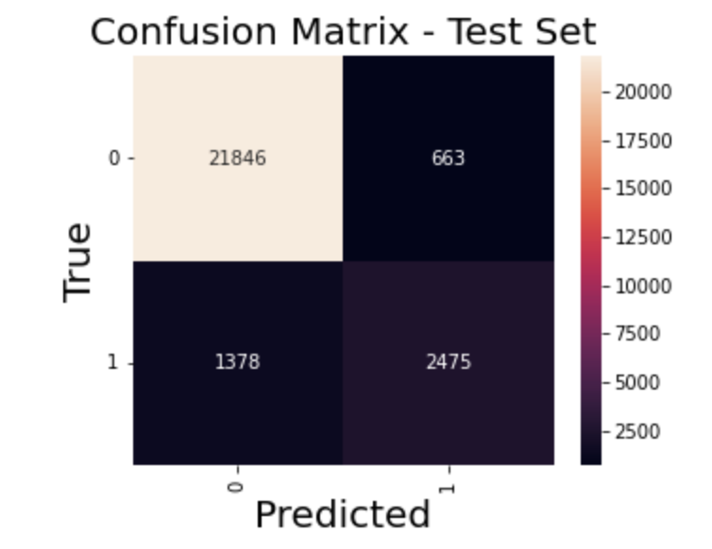
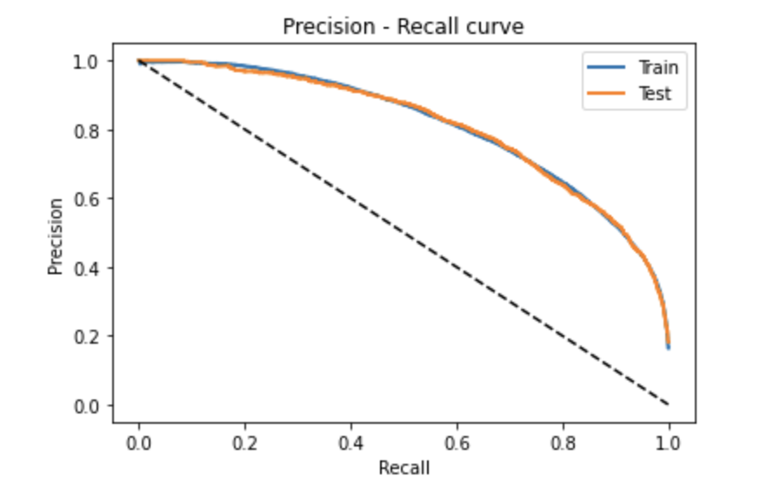
Results – Logistic regression
Hyperparameters:
C = 0.1, solver = ‘liblinear’, penalty = ‘l2’,
max_iter = 200
PR AUC on test data: 80.965
Results on test data for each class

Slide 45
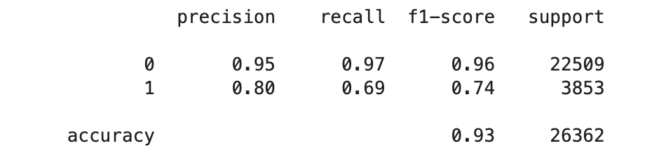
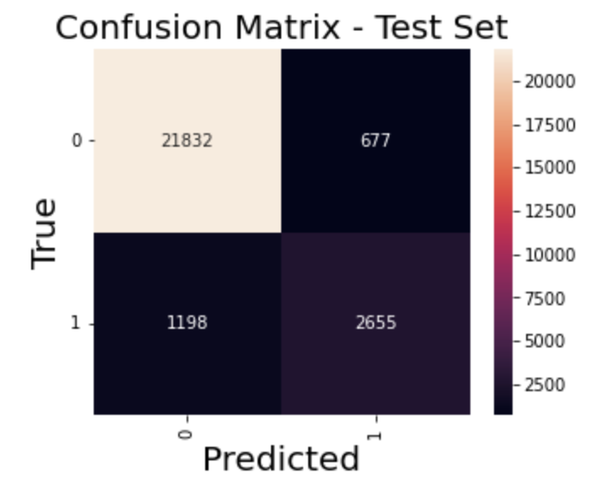
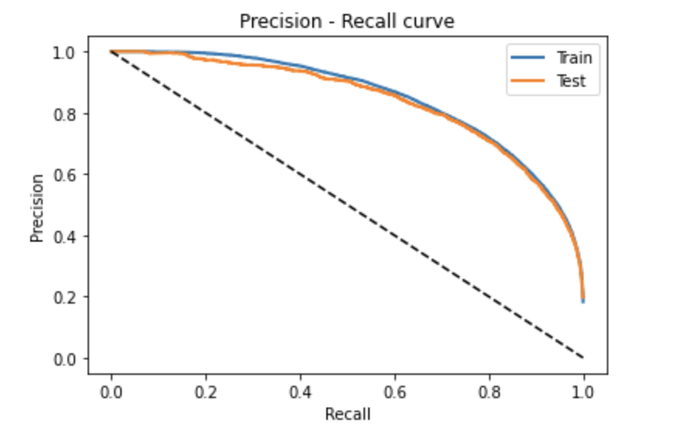
Results – XGBoost
Hyperparameters:
n_estimators = 200, learning_rate = 0.05,
subsample = 1, max_depth = 6, max_features = 1
PR AUC on test data: 83.766
Results on test data for each class

Slide 46
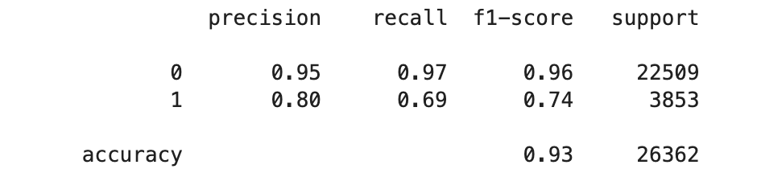
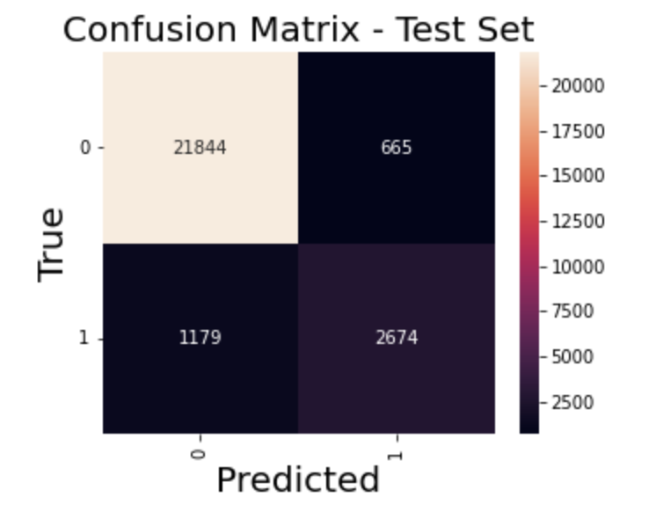
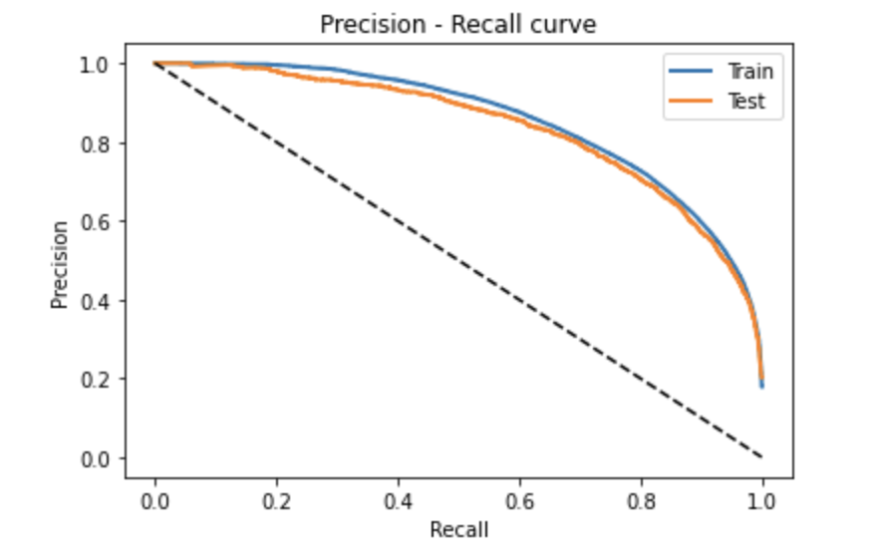
Results – Logistic regression with transformed features
Hyperparameters:
C = 0.01, solver = ‘liblinear’, penalty = ‘l2’,
max_iter = 200
PR AUC on test data: 83.742 (3.42% improvement)
Results on test data for each class

Slide 47
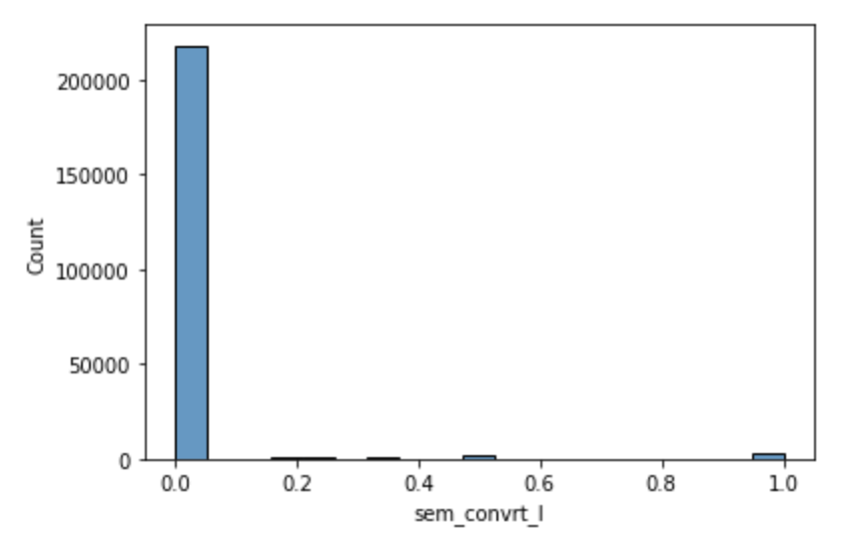
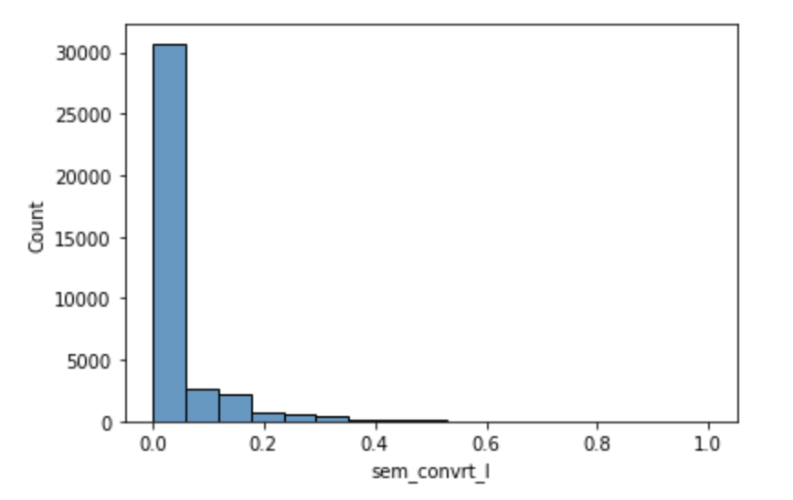
CVR distribution in each class
CVR distribution in class 0
CVR distribution in class 1
Class 0:
Mean CVR = 0.0220
Median CVR = 0.0
Class 1:
Mean CVR = 0.0324
Median CVR = 0.0

Slide 48
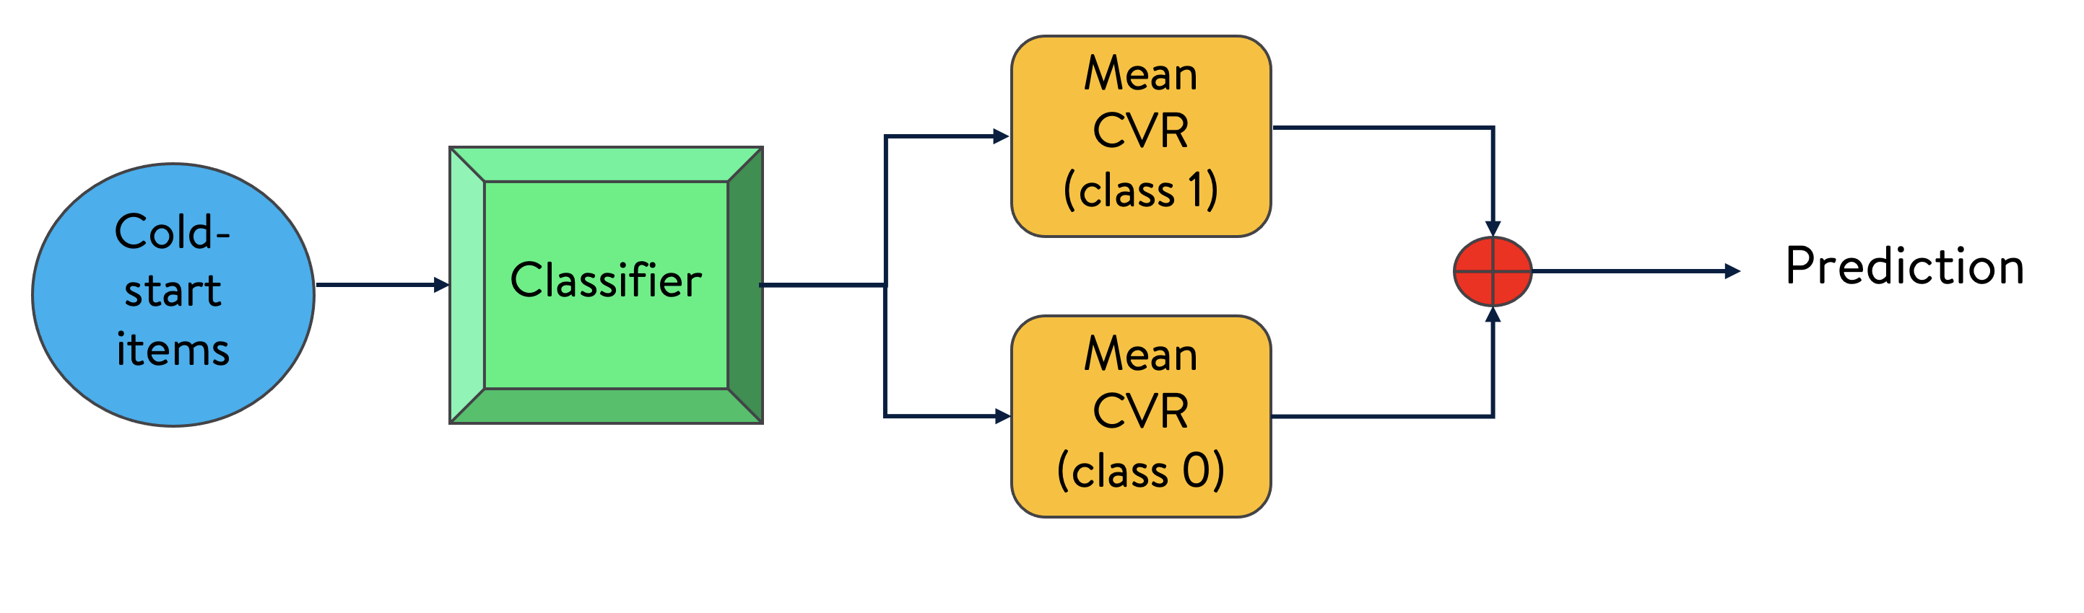
Estimate CVR for cold-start items
Metric | Value
Mean cross entropy | 0.1134
Normalized Mean cross entropy | 0.2016
Mean KL-divergence | 0.0905
Mean Absolute Error | 0.0445

Slide 49
What if ?
Procedure:
Advertisement spending is an important feature (high feature importance)
For cold-start items, we replace their original spending with the average spending across L3 – hierarchy (from segmented products)
We predict the CVR from the model built on the segmented data
Observations:
We randomly sample 10% of the cold-start items
The original spending is replaced accordingly
Close to 26k (98% of the sampled cold-start items) have their original spending less than the replaced value

Slide 50
Further observations
Items with zero CVR but predicted CVR < 0.01
Items with zero CVR but predicted CVR >= 0.05
Original spending:
Mean = 0.47
Median = 0.23
Replaced spending:
Mean = 18.59
Median = 12.54
Original spending:
Mean = 0.26
Median = 0.09
Replaced spending:
Mean = 5.49
Median = 3.91
Very low CVR in spite of higher spending
Potential candidates that could do well

Slide 51
Next Steps

Slide 52
Next Steps
Study the effect of item name/description on the conversion rate (CVR)
Train better classification algorithms to improve the overall performance – XGBoost, Light GBM, CatBoost etc.
To effectively use the transformed features for better performance
Better feature engineering techniques – K-means code book vectors, RT Embeddings etc.
Modelling the Revenue Per Click (RPC) for all the items
During inference, we might not know whether an item is a cold-starter!

Slide 54
Appendix

Slide 55
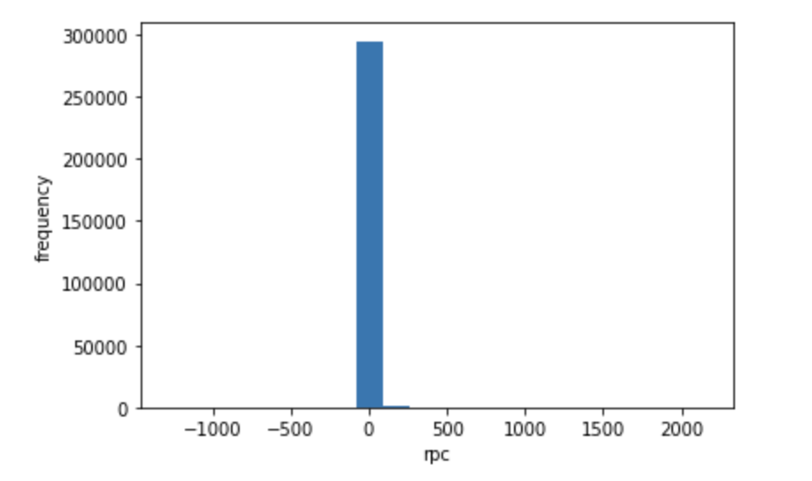
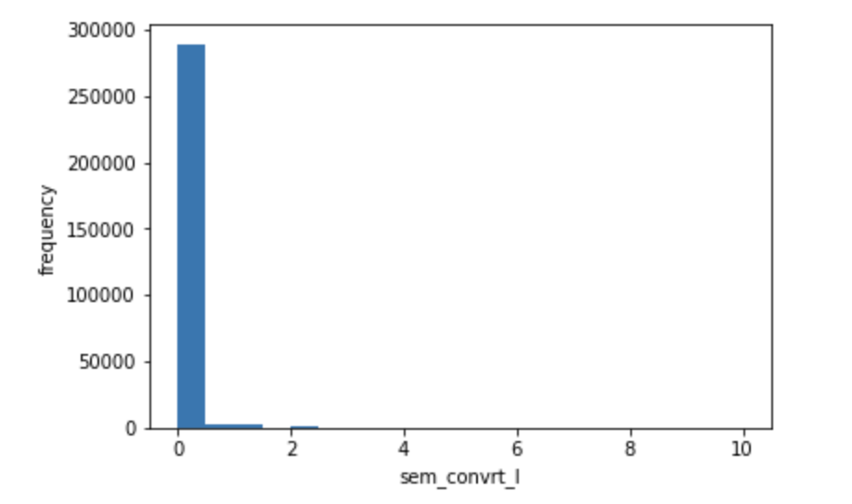
Key observations
Close to 90% of the data points have their conversion rate and RPC equal to zero
Fig: Histograms of the target variables RPC (left) and CVR (right)

Slide 56
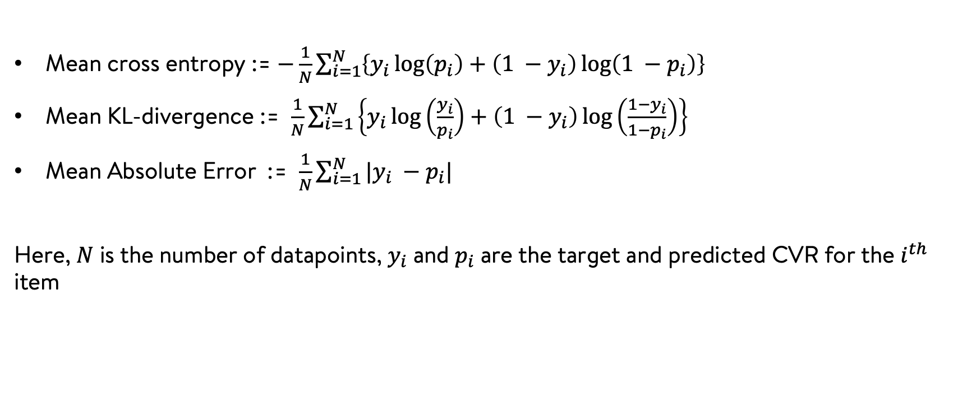
Evaluation metrics
Mean cross entropy := $−\frac{1}{N}\sum_{i=1}^{N}{\left\{y_{i}\log\left(p_{i}\right)+\left(1 −y_{i}\right)\log\left(1 −p_{i}\right)\right\}}$
Mean KL-divergence := $\frac{1}{N}\sum_{i=1}^{N}{\left\{y_{i}\log\left(\frac{y_{i}}{p_{i}}\right)+\left(1 −y_{i}\right)\log\left(\frac{1−y_{i}}{1−p_{i}}\right)\right\}}$
Mean Absolute Error := $\frac{1}{N}\sum_{i=1}^{N}{|y_{i} −p_{i}|}$
Here, $N$ is the number of datapoints, $y_{i}$ and $p_{i}$ are the target and predicted CVR for the $i^{th}$ item

Slide 57
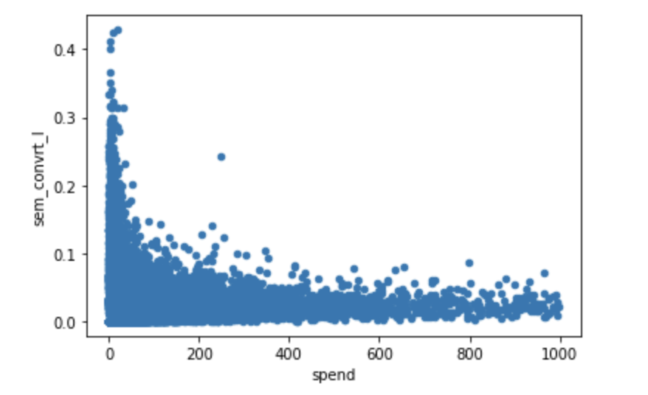



Feature selection and engineering
Box-Cox transformations for numerical features:
Fig: Box-Cox transformations

Slide 58

Gaussian mixtures
Likelihood: $p\left(x \right| Y=y)= \sum_{k=1}^{K_{y}}{π_{k}.𝒩\left(x \right| μ_{k}, Σ_{k});} Y=0, 1, …, n$
Prior: $p(Y=y)$ = $\frac{N_{y}}{N}$
Posterior: $p\left(Y=y \right| x) ∝p\left(x \right| Y=y).p(Y=y)$
Here, $x, Y, K_{y}, N_{y}, N, n$ represent the input feature, target class, number of clusters (components) in class $y$, number of datapoints in class $y$, total number of datapoints, and the number of classes respectively

Slide 59




Results – Classification head (n = 2)
Hyperparameters:
n_estimators = 100, learning_rate = 0.1, subsample = 1,
max_depth = 3, max_features = 1
Results from 10-fold cross validation:
ROC AUC: 77.883 $±$ 0.033
ROC AUC on test data: 80.458
Results on test data for each class

Slide 60
Results – Logistic regression + blender (n = 2)
Results on Test data:
Mean cross entropy = 0.1315
Normalized mean cross entropy = 0.8724
Mean KL-divergence = 0.0167
Mean Absolute Error = 0.0234
Class | Mean Absolute Error (MAE)
Class 0 | 0.0279
Class 1 | 0.021
MAE of all products of a particular class is shown in the table

Slide 61


Results – Gradient boosted decision trees (threshold = 20)
Hyperparameters:
n_estimators = 100, learning_rate = 0.1, subsample = 1,
max_depth = 3, max_features = 1
ROC AUC on test data: 73.524
Results on test data for each class

Slide 62
Results – Logistic regression + blender (threshold = 20)
Results on Test data:
Mean cross entropy = 0.1349
Normalized mean cross entropy = 0.8544
Mean KL-divergence = 0.0207
Mean Absolute Error = 0.0208
Class | Median Absolute Error
Class 0 | 0.0246
Class 1 | 0.0114
Class 2 | 0.0098
Class 3 | 0.0338
Class 4 | 0.0978
Median AE of all products of a particular class is shown in the table

Slide 63
References

Slide 64
References
BETA REGRESSION FOR MODELLING RATES AND PROPORTIONS.ime.usp.br/~s
Practical Lessons from Predicting Clicks on Ads at Facebook

